Slide 1

Capstone Project
by Jian Zhou

Slide 2


Slide 3
Objectives
Express / Node JS backend to provide data CRUD operations.
Next.js frontend with ReactJS / typescript to cater a full featured UI.
Authentication for admin users to manage backend data.

Slide 4
Technologies / Tools
MongoDB / Cloud
Next JS / React / Typescript
Tailwind CSS / Elements
GitHub
HTML Canvas
Express / Node JS

Slide 5
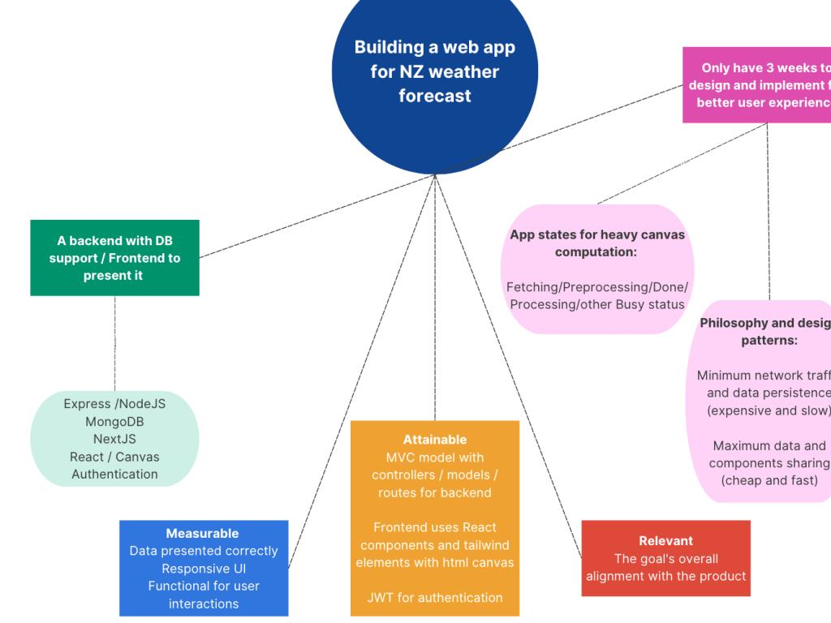
Outline

Slide 6
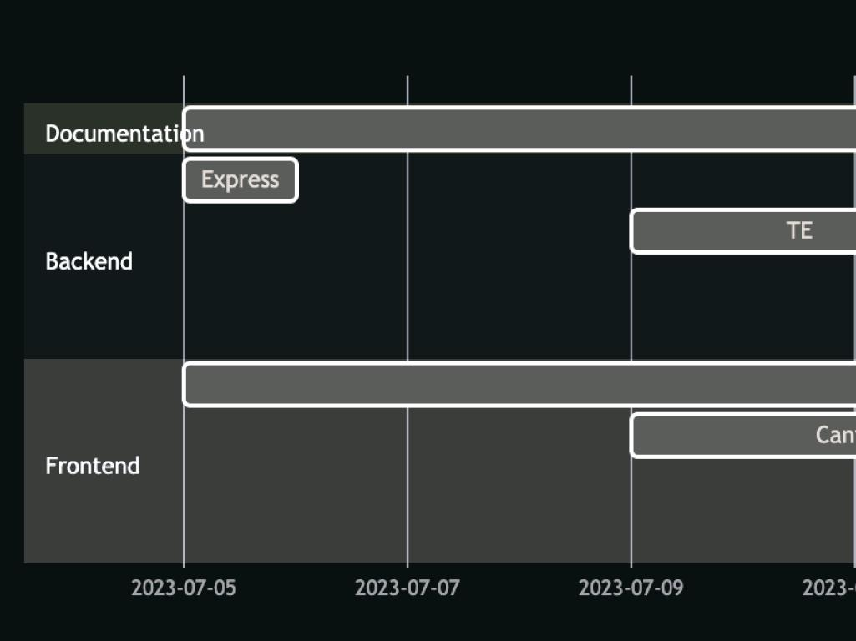

Slide 7
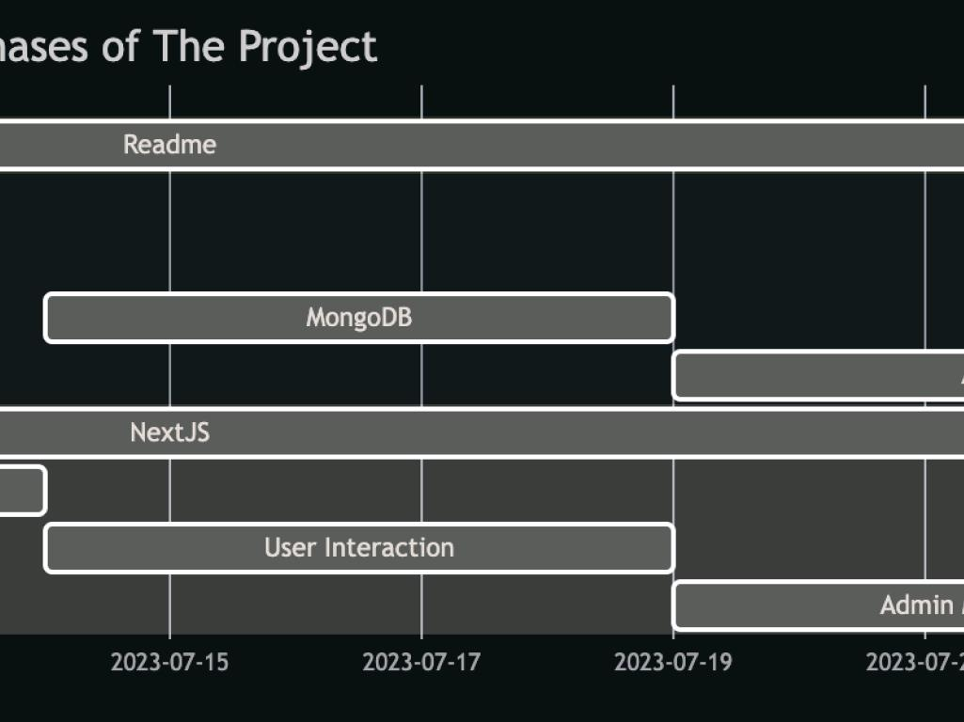

Slide 8
The Backend
Utilize the weather API and build a backend to cache data for it
Improve the functionality to facilitate weather checking for New Zealand by incorporating with geographic data.
Use online data from the United Nations and parse it.
Adding areas, distance and forced fresh queries for NZ users

Slide 9
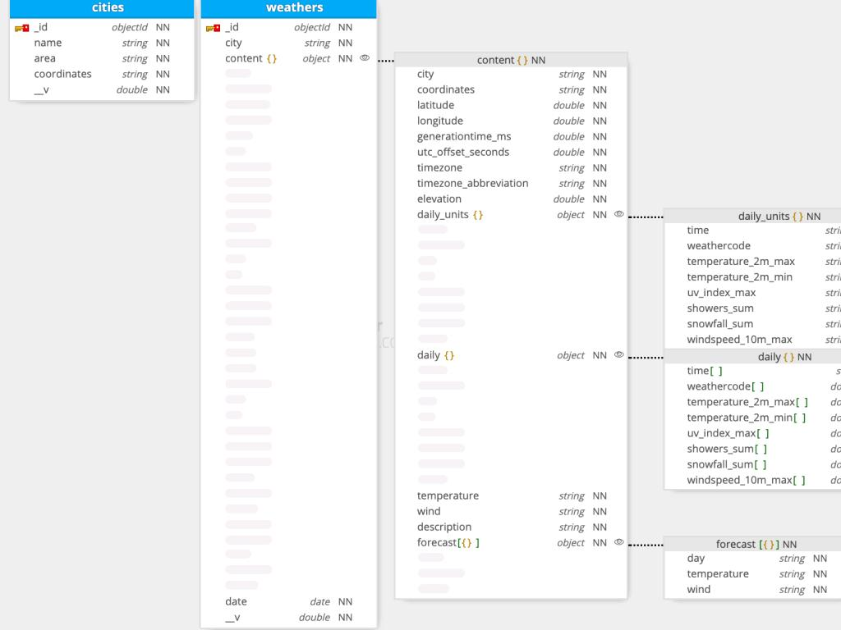
Schema

Slide 10
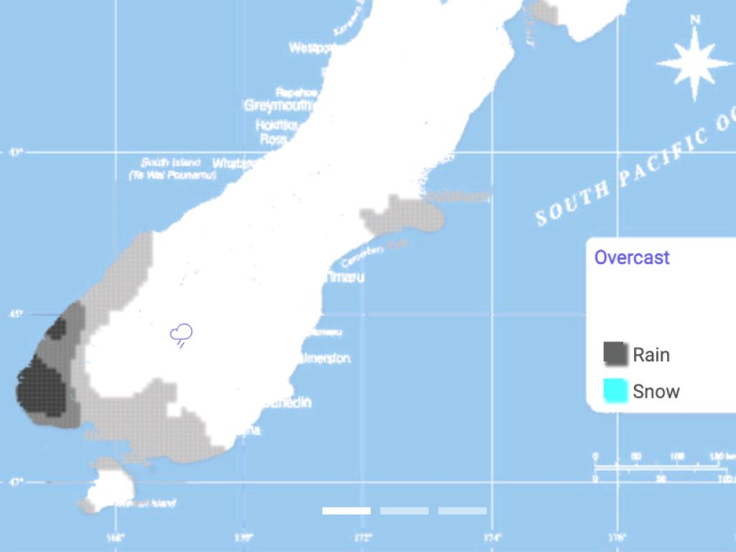
Frontend
Responsive design

Slide 11
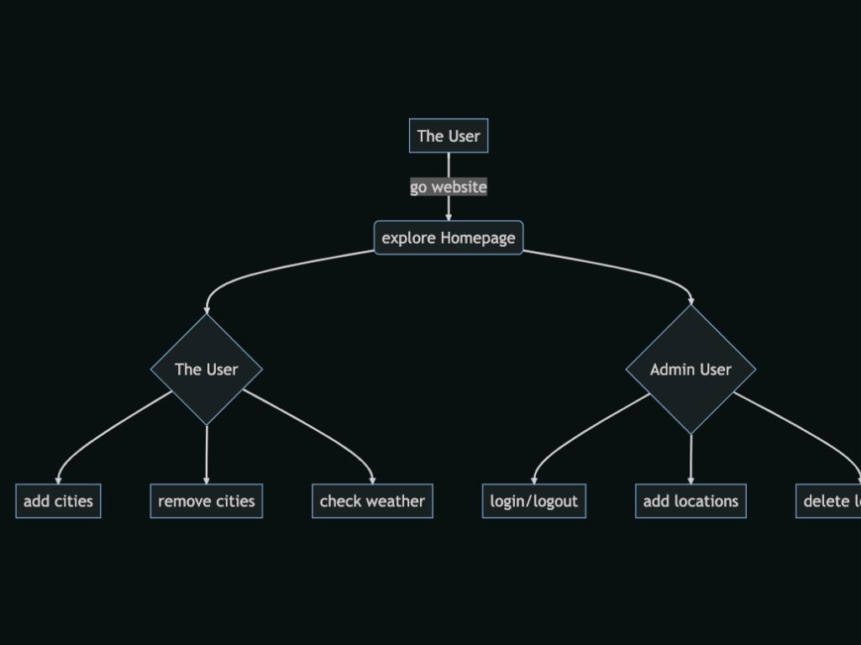
Workflow

Slide 12
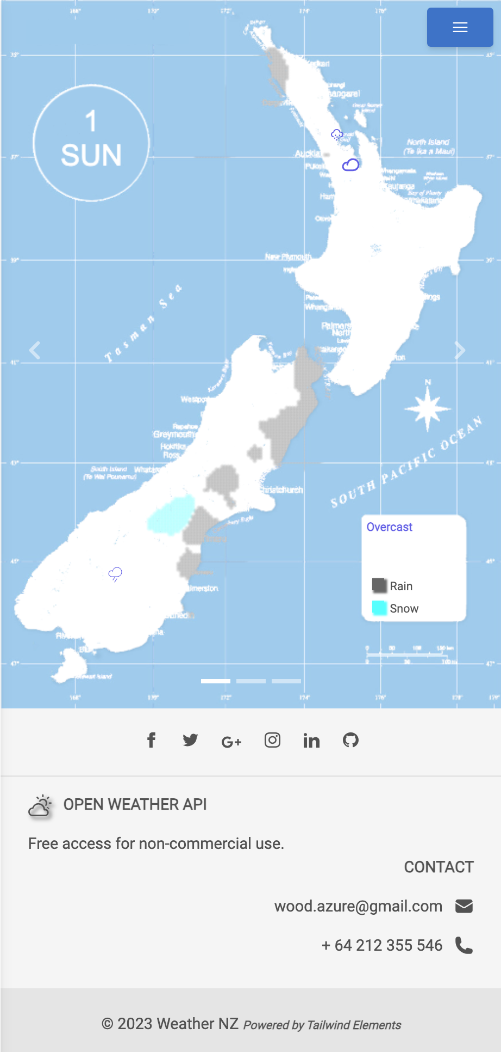
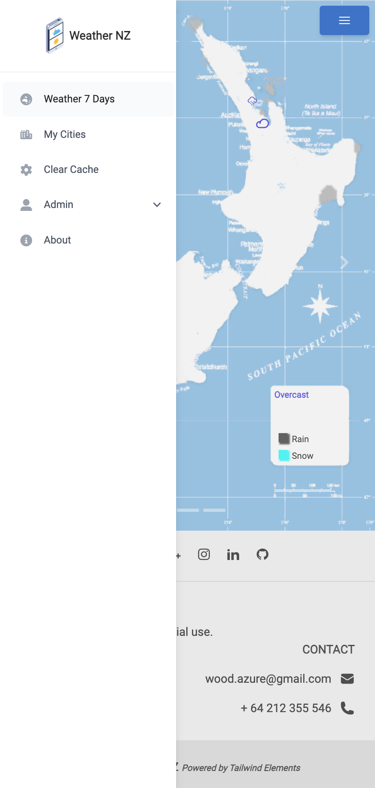

Slide 13
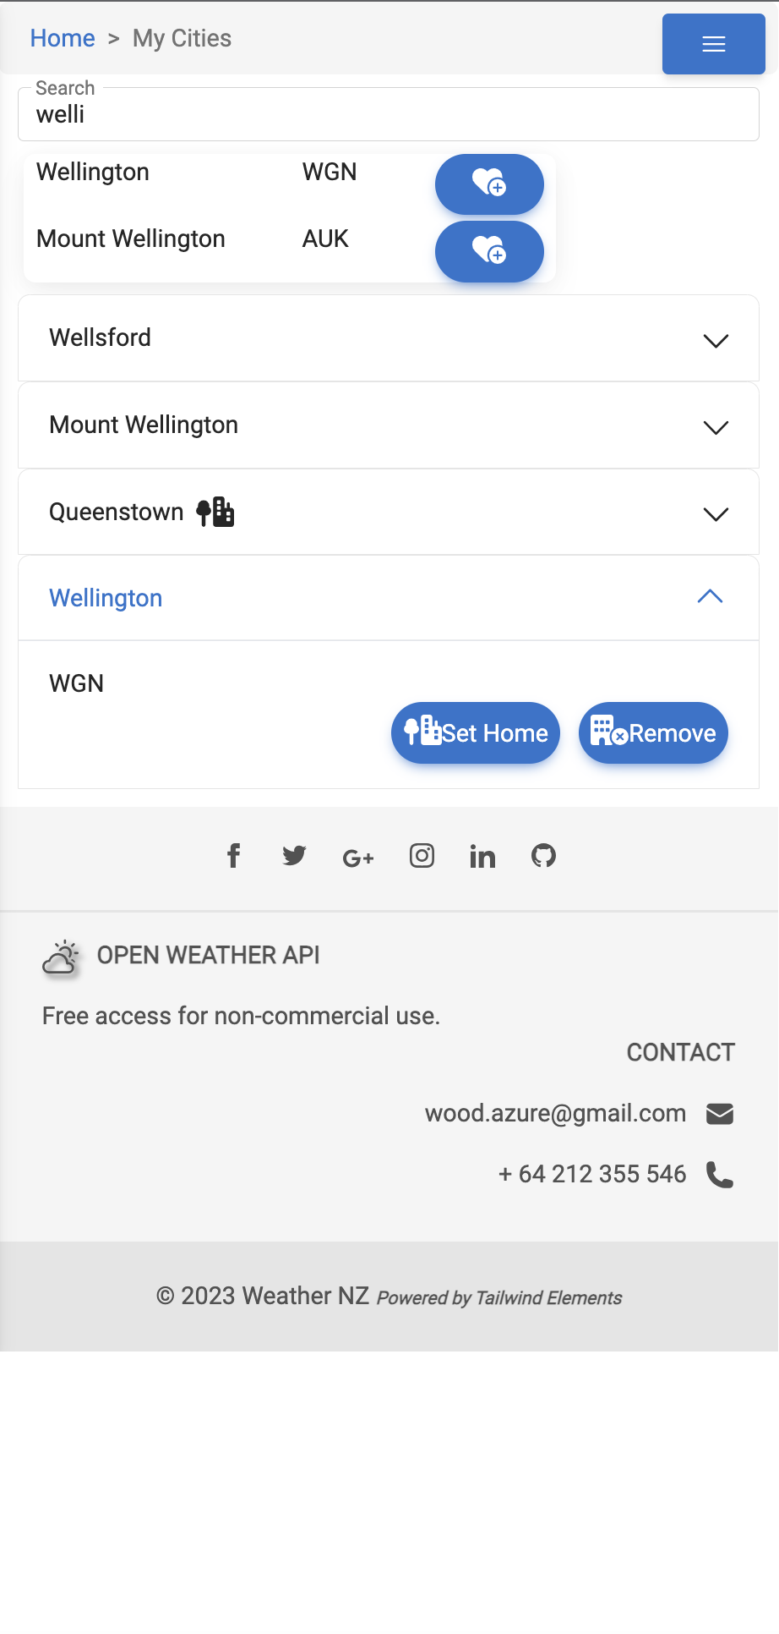
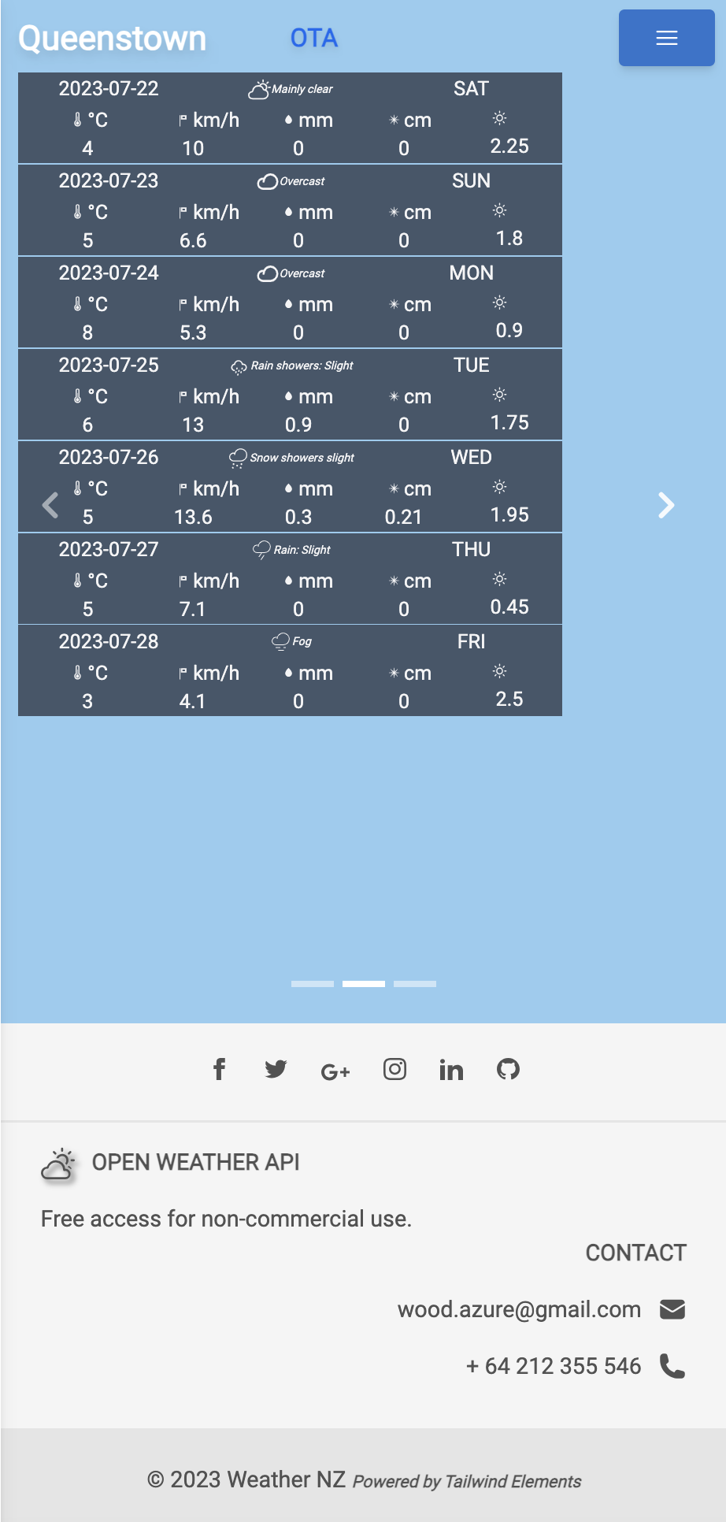
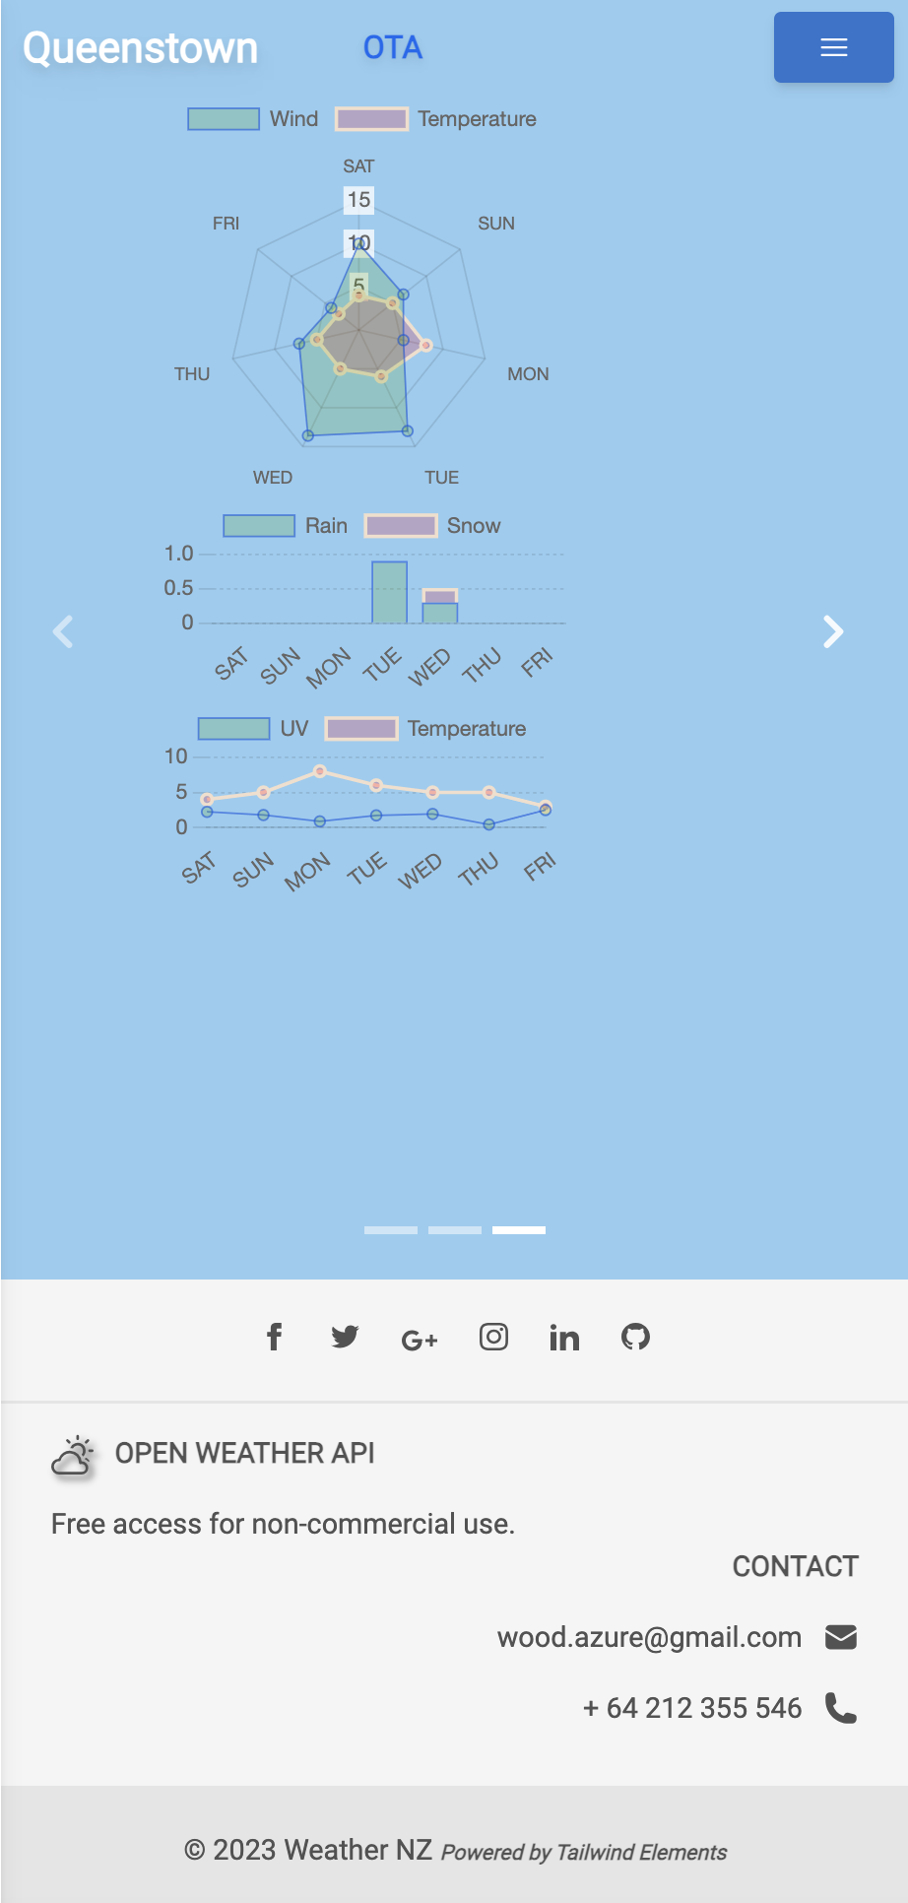

Slide 14
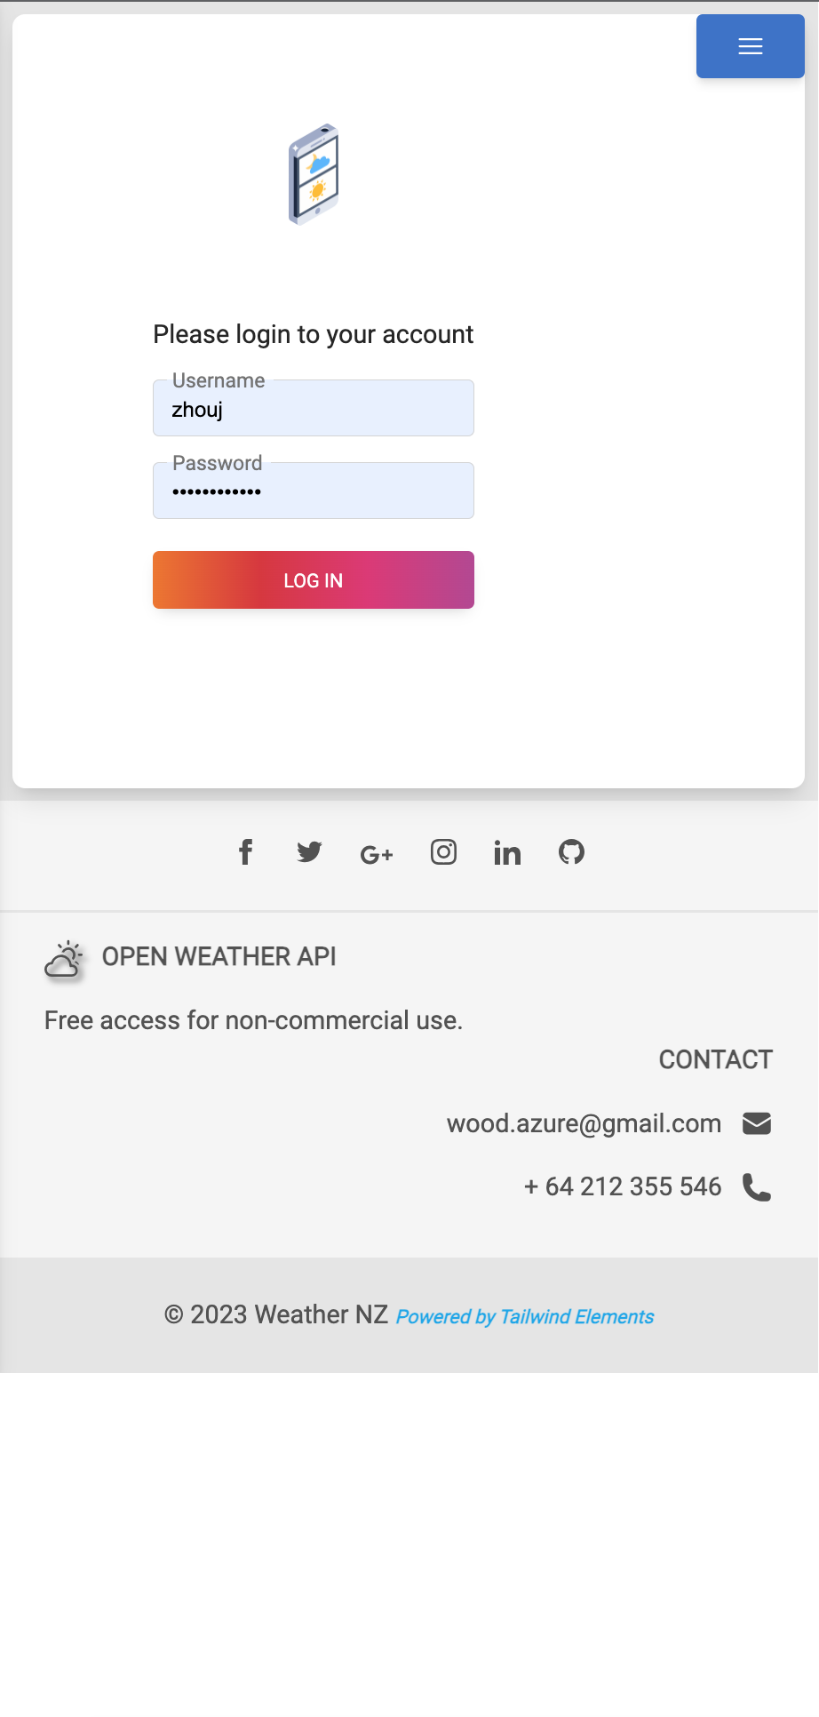
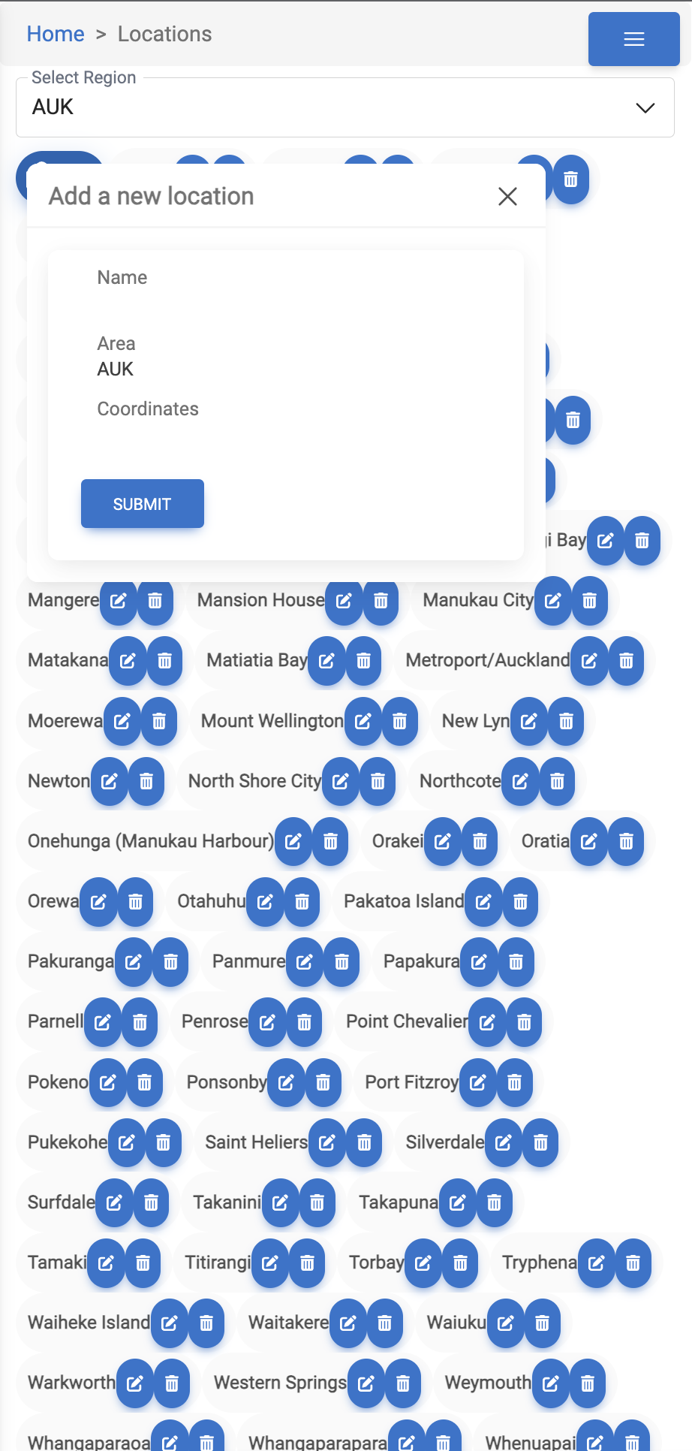
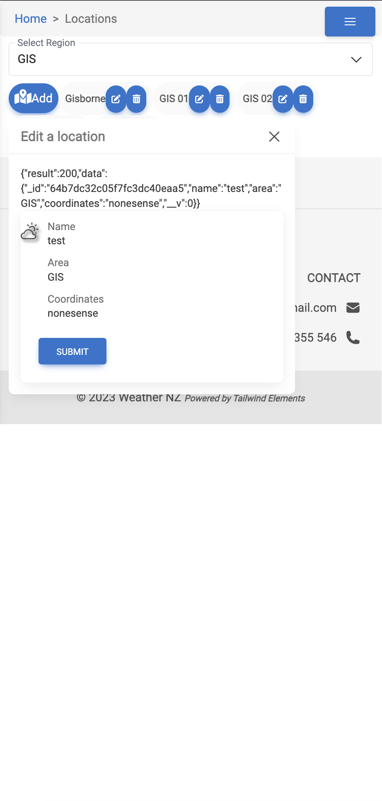

Slide 15
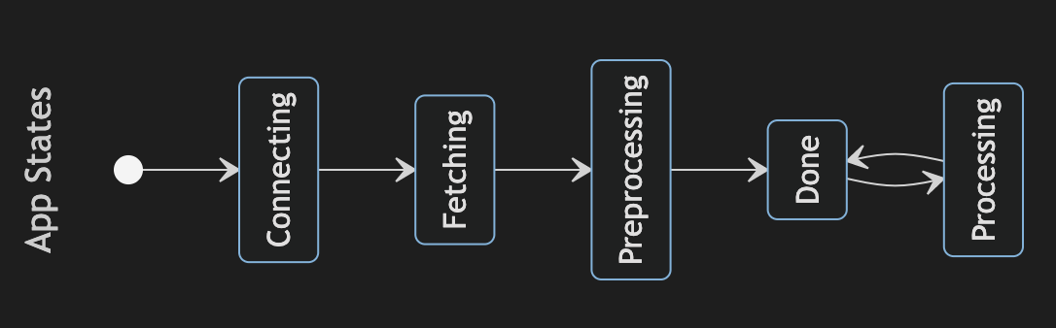
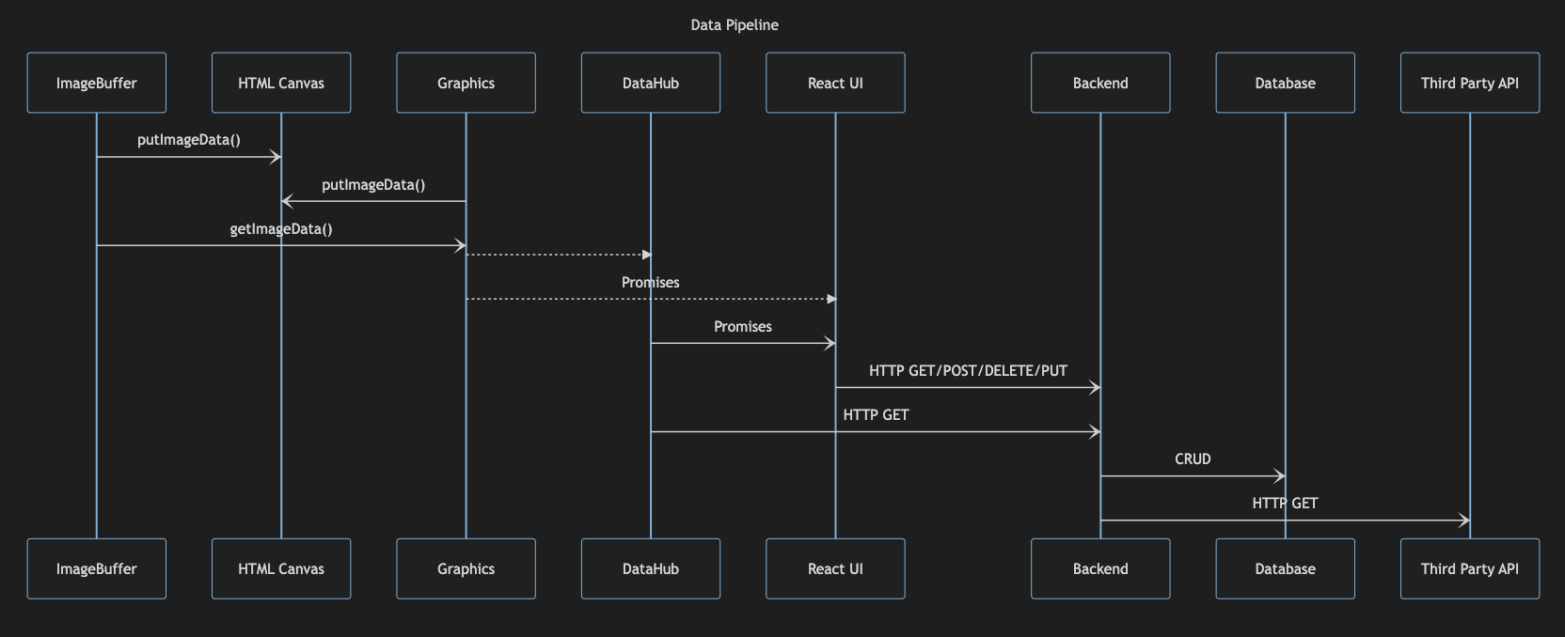
Frontend State Management
Backend/Frontend Data Pipeline

Slide 16
Summary
Stakeholders
Frontend State Management
Conceptual Ideas
Design Patterns
DevOps Strategic Alignment

Slide 17
Thank you!
Please visit https://weather-nz.vercel.app/

